Slide 1
C41
Single clock cycle
Giải đáp

Slide 2
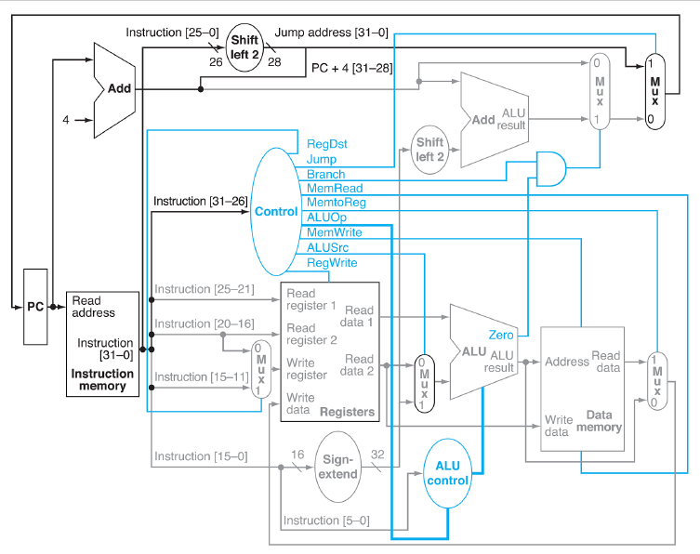
Datapath
4
3
5
1
2

Slide 3
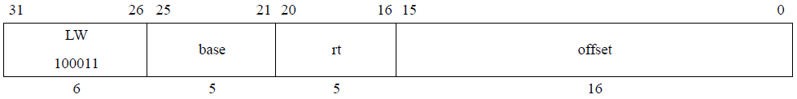
C41.B3 (lw)
lw $s0,8($a0)
rt ← memory[base+offset]
RegDest | RegWrite | MemRead | MemWrite | MemtoReg | Branch | Jump | ALUSrc
0 | 1 | 1 | 0 | 1 | 0 | 0 | 1

Slide 4
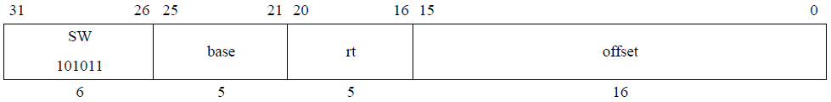
C41.B3 (sw)
sw $s0,8($a0)
memory[base+offset] ← rt
RegDest | RegWrite | MemRead | MemWrite | MemtoReg | Branch | Jump | ALUSrc
x | 0 | 0 | 1 | 0 | 0 | 0 | 1

Slide 5
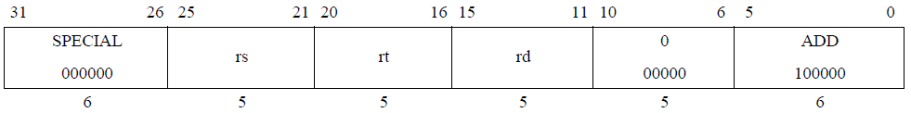
C41.B3 (add)
add $s0,$s1,$s2
rd ← rs + rt
RegDest | RegWrite | MemRead | MemWrite | MemtoReg | Branch | Jump | ALUSrc
1 | 1 | 0 | 0 | 0 | 0 | 0 | 0

Slide 6
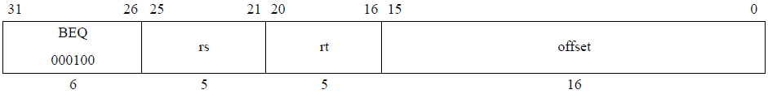
C41.B3 (beq)
beq $t2,$t1,label
if rs = rt then branch
RegDest | RegWrite | MemRead | MemWrite | MemtoReg | Branch | Jump | ALUSrc
x | 0 | 0 | 0 | 0 | 1 | 0 | 0

Slide 7
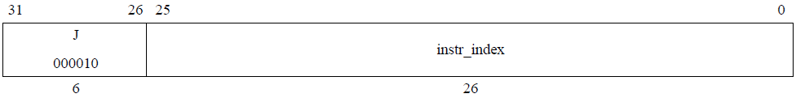
C41.B3 (j)
j label
PC ← (PC+4)_{31..28} || instr_index || 00
RegDest | RegWrite | MemRead | MemWrite | MemtoReg | Branch | Jump | ALUSrc
x | 0 | 0 | 0 | 0 | 0 | 1 | x

Slide 8
C41.B4 (critical path lệnh load)
200ns
350ns
210ns
450ns
650ns
810ns
220ns
660ns
Load
210ns

Slide 9
C41.B4 (critical path lệnh store)
200ns
350ns
650ns
450ns
220ns
Store
350ns
210ns

Slide 10
C41.B4 (critical path lệnh arith)
200ns
210ns
350ns
620ns
460ns
360ns
470ns
Arith

Slide 11
C41.B4 (critical path lệnh branch)
10ns
230ns
210ns
220ns
470ns
460ns
480ns
200ns
350ns
360ns
Branch

Slide 12
C41.B4 (critical path lệnh jump)
210ns
10ns
220ns
200ns
Jump

Slide 13
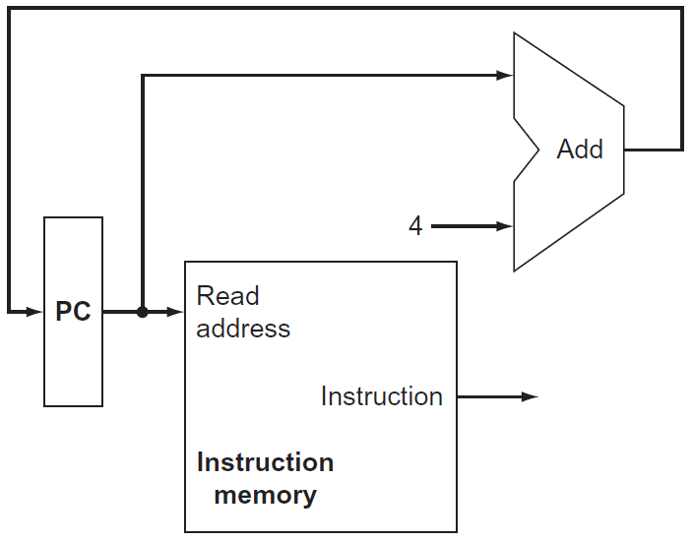
PC - IM
Program Counter (PC): Thanh ghi chứa địa chỉ lệnh trong chương trình đang được thực thi.
Instruction Memory (IM):
  Chứa toàn bộ chương trình cần thực thi.
  Là bộ nhớ chỉ đọc, không cần tín hiệu điều khiển.
  Input: địa chỉ lệnh được thực thi.
  Output: mã máy của lệnh được thực thi.

Slide 14
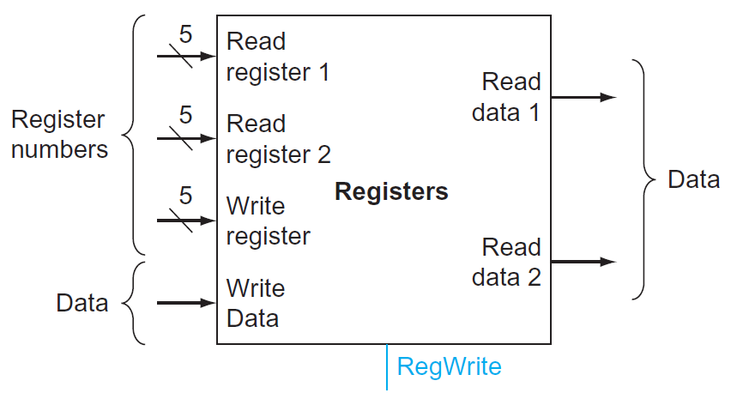
Registers
Chứa tất cả thanh ghi của CPU.
Inputs:
  2 ngỏ nhập địa chỉ đọc
  1 ngỏ nhập địa chỉ ghi
  1 ngỏ nhập dữ liệu ghi
Outputs: 2 ngỏ xuất dữ liệu đọc
Hoạt động đọc thanh ghi không cần tín hiệu điều khiển.
Ngược lại, hoạt động ghi thanh ghi cần được báo hiệu bằng tín hiệu kích cạnh RegWrite.

Slide 15
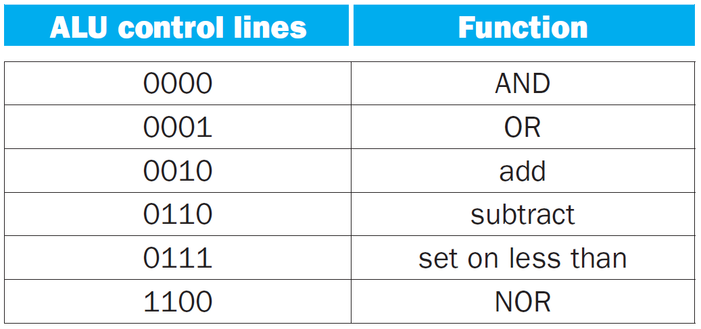
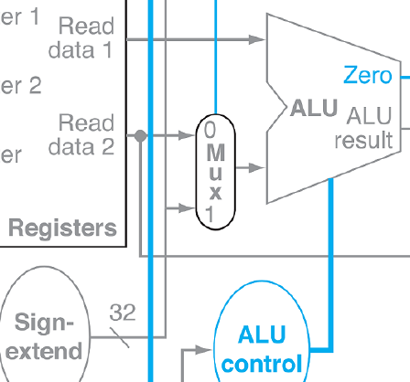
ALU
Inputs:
  Dữ liệu 32 bits từ khối Registers đưa qua.
  Dữ liệu tức thời (immediate) 16 bits từ mã máy lệnh, mở rộng dấu thành 32 bits.
  ALU control: chọn phép toán.
Outputs:
  ALU result: kết quả
  Zero: lên 1 khi kết quả bằng không (hoặc lên 1 khi kết quả so sánh là đúng).
ALUsrc

Slide 16
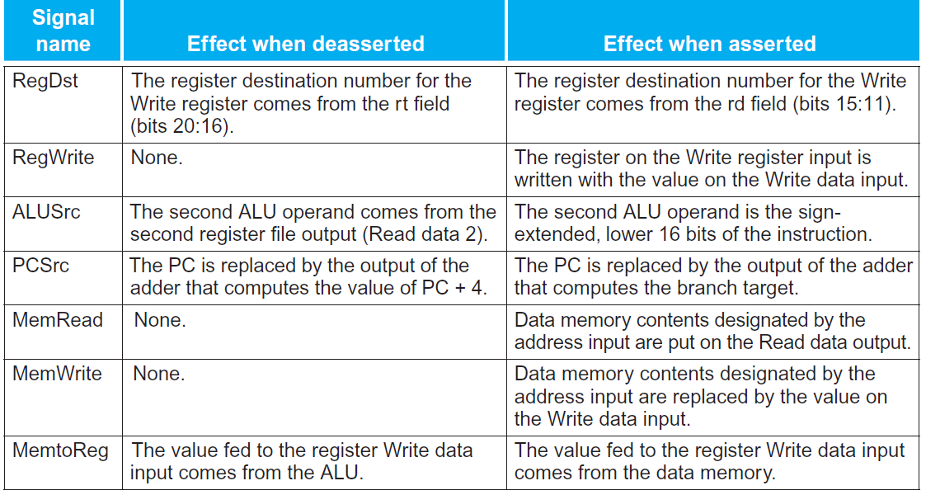
Control

Slide 17
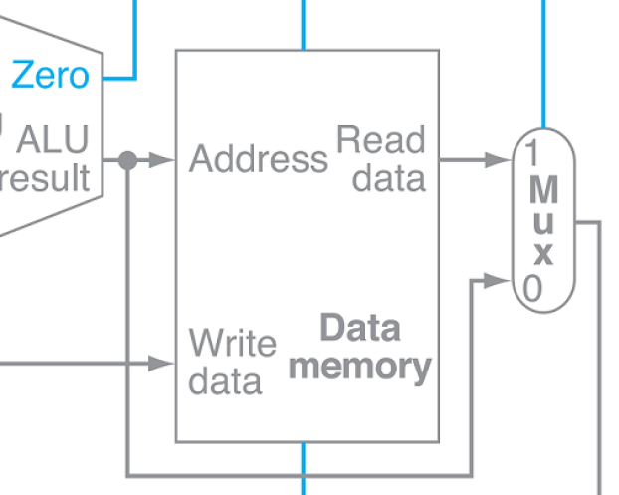
Data Memory (DM)
ALU
Registers

Slide 18
C42
Pipeline
Giải đáp

Slide 19
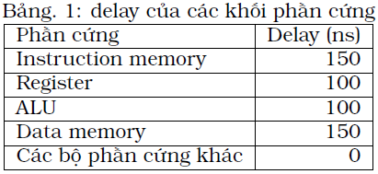
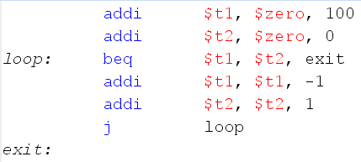
C42B1a Xác định chu kỳ CR
SC: T_{CR1} = D_{IM} + D_{Regs} + D_{ALU} + D_{DM} + D_{Regs} = 600 ns
MC: T_{CR2} = max(D_{i}) = 150 ns
PL: T_{CR3} = max(D_{i}) = 150 ns

Slide 20
C42.B1b Xác định IC
Đọc hiểu đoạn code, xác định số lần lặp N.
Tính IC theo số lệnh thực thi:
IC = addi + addi + N * (beq + addi + addi + j) + beq
  = 203 lệnh
(50)

Slide 21


C42.B1b,B1c Tính T_{p} - Speedup
SC: T_{P} = (IC * 1) * T_{CR1} = 203 * 600 ns = 121,800 ns
MC: T_{P} = ((IC_{arith}*4) + (IC_{branch}*3) + (IC_{jump}*2)) * T_{CR2}
= (102*4 + 51*3 + 50*2) * 150ns
= 99,150 ns
Speedup1 $= \frac{121,800}{31,050}=$
(3.92)
Speedup2 $= \frac{99,150}{31,050}=$
(3.19)
PL: T_{P} = (IC - 1+<số bước pipeline>) * T_{CR3}
= (202 + 5) * 150ns
= 31,050 ns

Slide 22
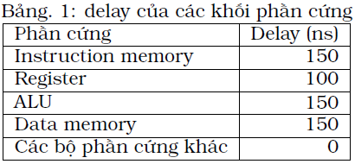
C42B1d Thay đổi
SC: T_{CR1} = D_{IM} + D_{Regs} + D_{ALU} + D_{DM} + D_{Regs} = 650 ns
MC: T_{CR2} = max(D_{i}) = 150 ns
PL: T_{CR3} = max(D_{i}) = 150 ns
không đổi

Slide 23

C42.B1d Tính lại T_{p} - Speedup
SC: T_{P} = (IC * 1) * T_{CR1} = 203 * 650 ns = 131,950 ns
PL: T_{P} = 31,050 ns
Speedup1 $= \frac{131,950}{31,050}=$
(4.25)

Slide 24
C42.B2a Xác định Data hazard
addi $t1,$zero,100
addi $t2,$zero,0
loop: beq $t1,$t2,exit
addi $t1,$t1,-1
addi $t2,$t2,1
j loop
exit:

Slide 25

C42.B2a Sự phụ thuộc các lệnh
addi $t1,$zero,100
addi $t2,$zero,0
loop:
beq
$t1,$t2,exit
addi $t1,$t1,-1
addi $t2,$t2,1
j loop

Slide 26
C42.B2b Chèn stalls
addi $t1,$zero,100
addi $t2,$zero,0
nop
loop: nop
beq $t1,$t2,exit
addi $t1,$t1,-1
addi $t2,$t2,1
j loop
exit:
addi $t1,$zero,100
addi $t2,$zero,0
loop: beq $t1,$t2,exit
addi $t1,$t1,-1
addi $t2,$t2,1
j loop
exit:
addi $t1,$zero,100
addi $t2,$zero,0
nop
nop
loop: beq $t1,$t2,exit
addi $t1,$t1,-1
addi $t2,$t2,1
nop
j loop
exit:

Slide 27
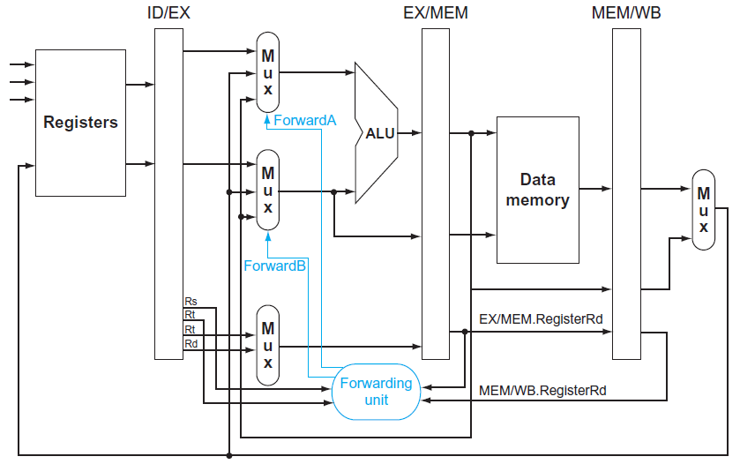
C42.B2c mạch đẩy tới (forward)
Không còn stall

Slide 28
C42.B2d sắp xếp lại lệnh
addi $t1,$zero,100
addi $t2,$zero,0
loop: beq $t1,$t2,exit
addi $t1,$t1,-1
addi $t2,$t2,1
j loop
exit:
addi $t2,$zero,0
addi $t1,$zero,100
loop: beq $t1,$t2,exit
addi $t2,$t2,1
addi $t1,$t1,-1
j loop
exit:
Không đổi

Slide 29
C42.B3a phụ thuộc lệnh
addi $t1,$zero,100
addi $t2,$zero,100
add $t3,$t1,$t2
lw $t4,0($a0)
lw $t5,4($a0)
and $t6,$t4,$t5
sw $t6,8($a0)

Slide 30
C42.B3b chèn nop
nop
addi $t1,$zero,100
addi $t2,$zero,100
nop
nop
add $t3,$t1,$t2
lw $t4,0($a0)
lw $t5,4($a0)
nop
nop
and $t6,$t4,$t5
nop
nop
sw $t6,8($a0)

Slide 31
C42.B3 đổi chỗ lệnh
addi $t1,$zero,100
addi $t2,$zero,100
nop
nop
add $t3,$t1,$t2
lw $t4,0($a0)
lw $t5,4($a0)
nop
nop
and $t6,$t4,$t5
nop
nop
sw $t6,8($a0)
addi $t1,$zero,100
addi $t2,$zero,100
lw $t4,0($a0)
lw $t5,4($a0)
add $t3,$t1,$t2
nop
and $t6,$t4,$t5
nop
nop
sw $t6,8($a0)
lw $t4,0($a0)
lw $t5,4($a0)
addi $t1,$zero,100
addi $t2,$zero,100
nop
and $t6,$t4,$t5
add $t3,$t1,$t2
nop
sw $t6,8($a0)
lw $t4,0($a0)
lw $t5,4($a0)
addi $t1,$zero,100
addi $t2,$zero,100
and $t6,$t4,$t5
nop
add $t3,$t1,$t2
sw $t6,8($a0)
Good job

Slide 32

Hết

